Slide 1
KA2 - Cooperation for innovation and the exchange of good practices
KA229 - School Exchange Partnerships
AROUND CULTURES SHARING HERITAGE TREASURES
01-09-2019 - 31-08-2021
2019-1-PL01-KA229-064929

Slide 3
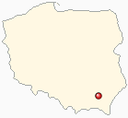
PARTNER SCHOOLS SZKOŁA PODSTAWOWA NR 2 RZESZ ÓW

Slide 4
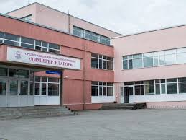
GENERAL SECONDARY SCHOOL NIKOLAY KATRANOV SVISHTOV

Slide 5
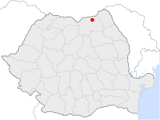
SCOALA GIMNASIALA MIHAI EMINESCU RAUDATI

Slide 6
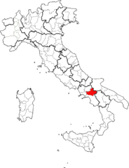
ISTITUTO COMPRENSIVO GROTTAMINARDA

Slide 7
CASA EN BAZA MISIONARES DEL DIVINO MAESTRO BAZA

Slide 8
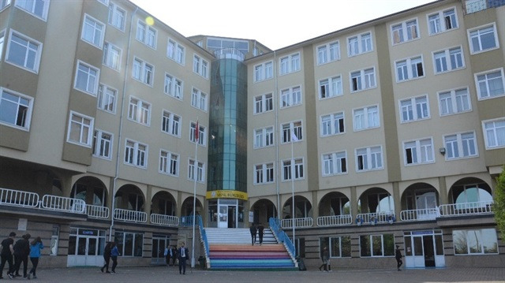
TRABZON SOSYAL BILIMLER LISESI

Slide 9
OBJECTIVES
developing cultural awareness, sensitivity and tolerance for other cultures and promote national heritage
improving the quality of education by developing the students' 21st century skills such as cultural awareness, communication and collaboration, creativity and innovation, critical thinking, problem-solving and decision-making, meta cognition and learning to learn, citizenship, life and career skills, personal and social responsibility, interpersonal skills and intercultural learning
strengthening the European dimension of education, providing teachers with modern teaching methods, developing digital skills and promote language teaching.
Our cultural heritage must be appreciated and preserved not only to keep our world more beautiful but also keep it as a compass to guide us in the future

Slide 10
PRIORITIES AND TOPICS
Social and educational value of European cultural heritage, its contribution to job creation, economic growth and social cohesion
Strengthening the profiles of the teaching professions
Supporting individuals in acquiring and developing basic skills and key competences
Cultural heritage
Creativity and culture
Overcoming skills mismatches

Slide 11
BUDGET SUMMARY
Project Management and Implementation 42000.00 EUR
Learning, Teaching, Training Activities 137648.00 EUR
Total Grant 179648.00 EUR
Szkola Podstawowa nr 2 Poland 32622.00 EUR
General Secondary School "Nikolay Katranov" Bulgaria 28421.00 EUR
Scoala Gimnaziala ,,Mihai Eminescu,, Radauti Romania 27407.00 EUR
Istituto Comprensivo Grottaminarda Italy 29182.00 EUR
CASA EN BAZA MISIONERAS DEL DIVINO MAESTRO Spain 31962.00EUR
Trabzon Sosyal Bilimler Lisesi Turkey 30054.00 EUR

