Slide 1
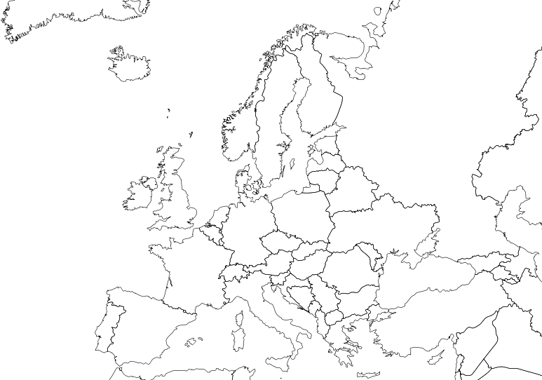
2017 - 2019
TAKE A STAND AND
LEND A HAND
PROJECT REFERENCE No:
2017-1-RO01-KA219-037085

Slide 2
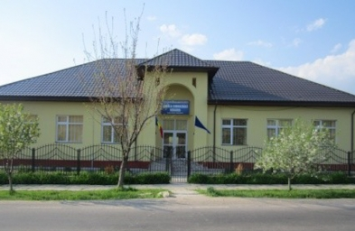
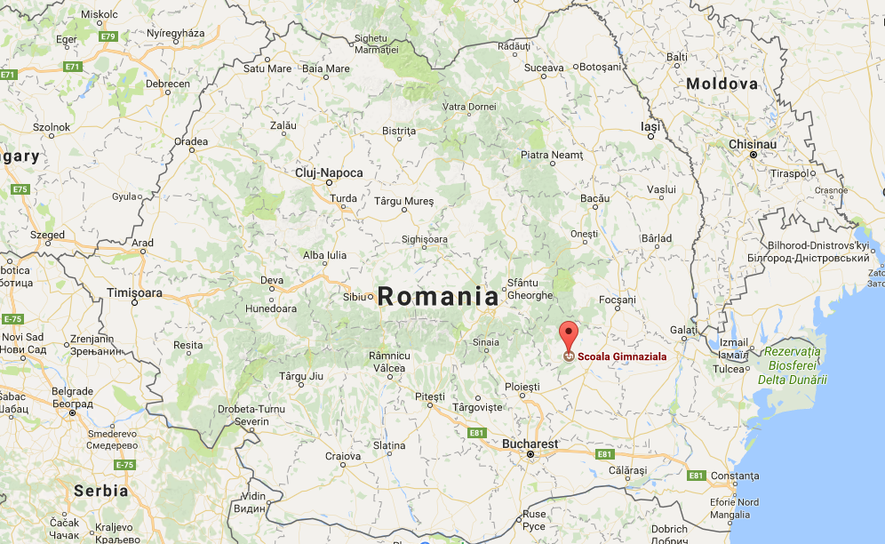
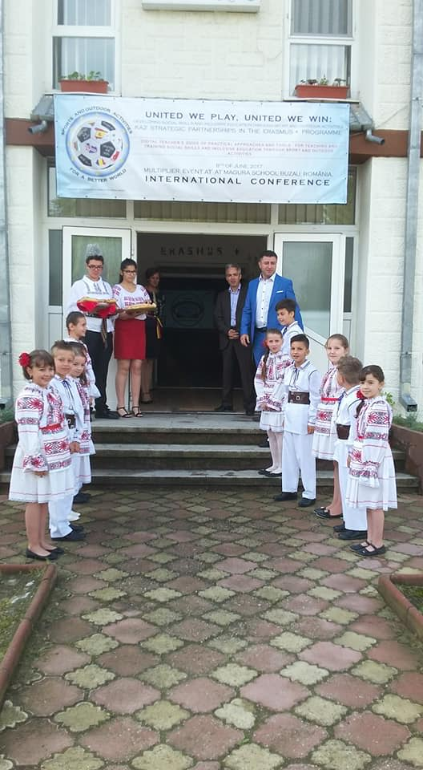
PARTNER SCHOOLS
Magura Secondary School, Buzau, Romania, project coordinator

Slide 3
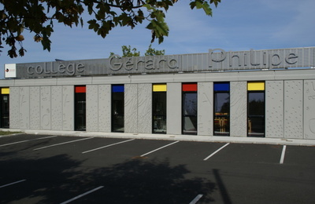
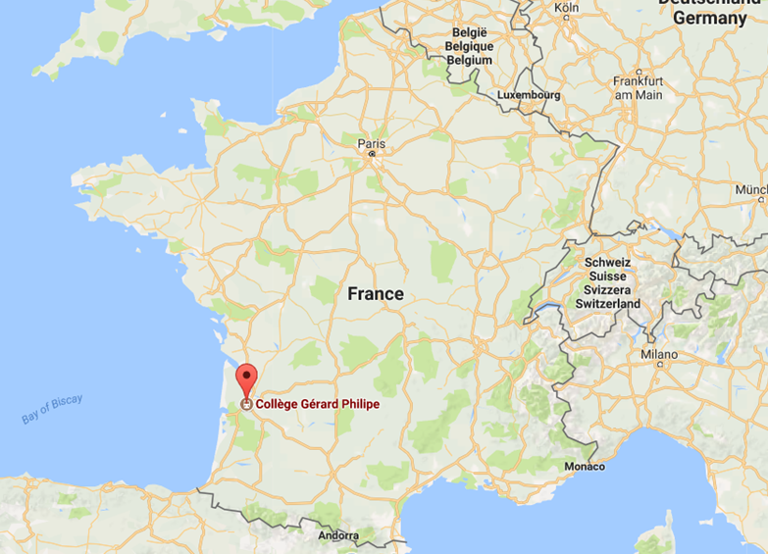
PARTNER SCHOOLS
College Gerard Philippe, Pessac,
France.

Slide 4
PARTNER SCHOOLS
Istituto Comprensivo Di Altopascio,
Italy.

Slide 5
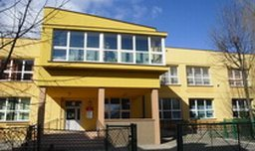
PARTNER SCHOOLS
Szkola Podstawowa nr 2 Rzeszów,
Poland.

Slide 6
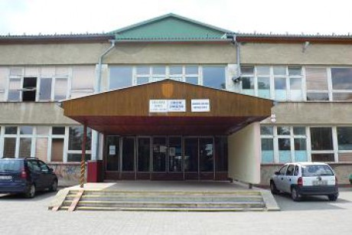
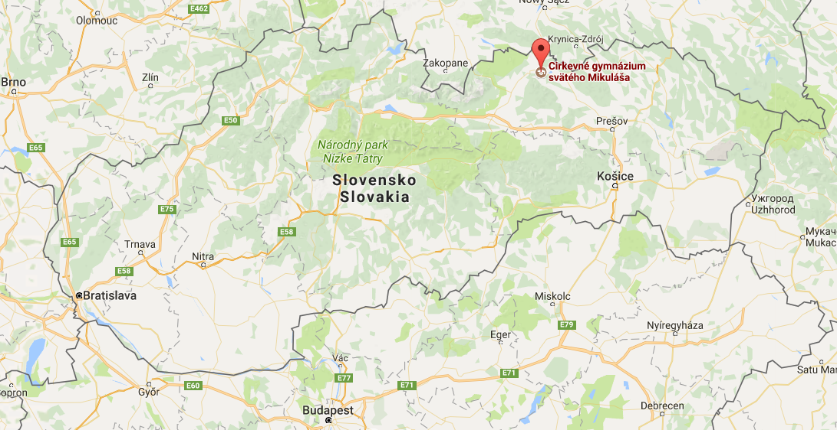
PARTNER SCHOOLS
Cirkevne gymnazium sv Mikulasa, Slovakia

Slide 7
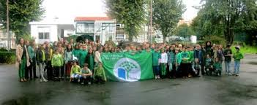
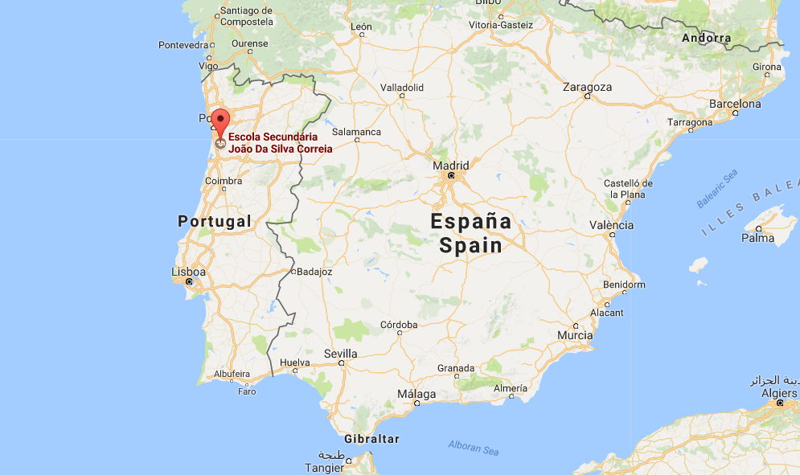
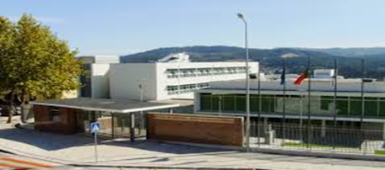
PARTNER SCHOOLS
Agrupamento de Escolas João da Silva Correia,
Portugal.

Slide 8
diminished the values representative for the bullying phenomenon by at least half of the present level;
So, at the end of the project, we will have:
cultivated in our students genuine respect and adherence to the European values of dignity, equality and human rights.
enriched the human relations as far as collaborative learning is concerned;

Slide 9
ACTIVITIES
Applying of questionnaires to students, parents and teachers about the main causes of aggression - diagrams
Adventure and exercise: respect and tolerance through sports.
Creating a blog on bullying
Making a guide called "I'm not ashamed of my deeds"

Slide 10
A set of pedagogical approaches meant to fight bullying;
Developing the skills specific to team work and collaborative learning;
OUTPUT RESULTS
All participant in the project will have broadened their cultural horizon, enabling them to relate to the others in a modern, European manner;
A significant drop in the number of bullying cases;

Slide 11
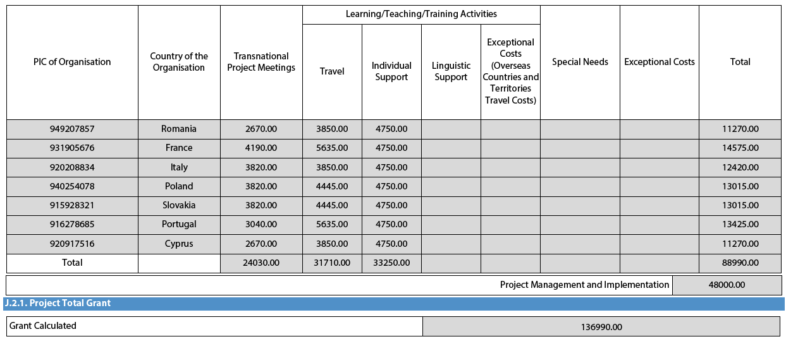
BUDGET SUMMARY

